Slide 1
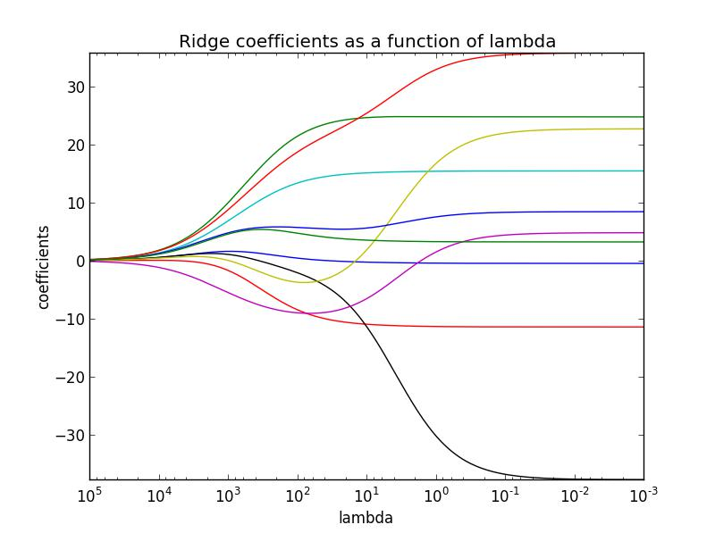
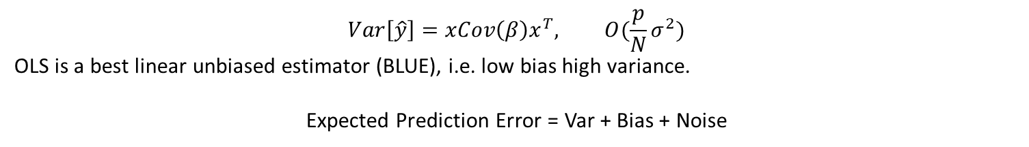
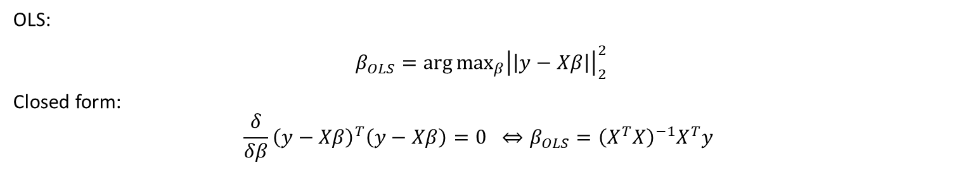
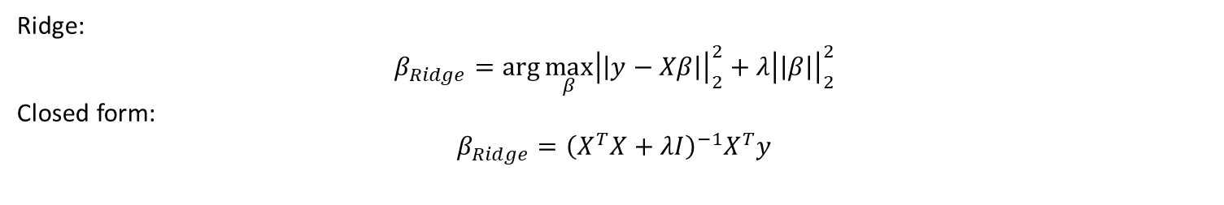
Lecture 1
OLS:
$β_{OLS}=\arg{\max_{β}{{\left|\left|y−Xβ\right|\right|}_{2}^{2}}}$
Closed form:
$$\frac{δ}{δβ}{\left(y−Xβ\right)}^{T}\left(y−Xβ\right)=0 ⇔β_{OLS}={\left(X^{T}X\right)}^{−1}X^{T}y$$
$$Var\left[\hat{y}\right]=xCov\left(β\right)x^{T}, O(\frac{p}{N}σ^{2})$$
OLS is a best linear unbiased estimator (BLUE), i.e. low bias high variance.
Expected Prediction Error = Var + Bias + Noise
Ridge:
$$β_{Ridge}=\arg{\max_{β}{{\left|\left|y−Xβ\right|\right|}_{2}^{2}+λ{\left|\left|β\right|\right|}_{2}^{2}}}$$
Closed form:
$$β_{Ridge}={\left(X^{T}X+λI\right)}^{−1}X^{T}y$$

Slide 2
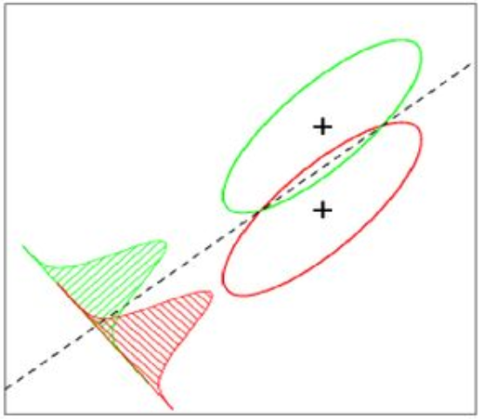
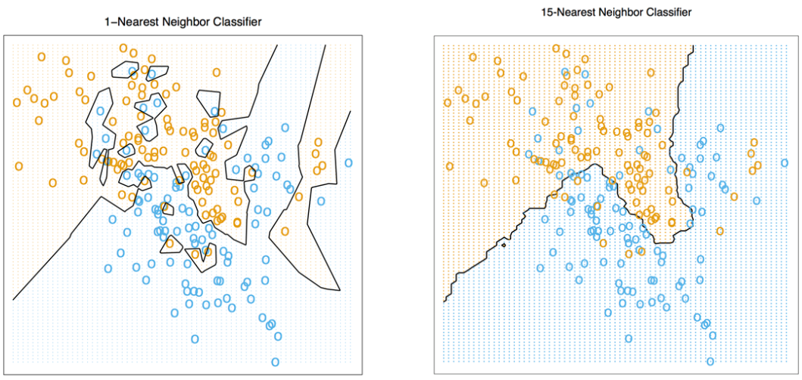
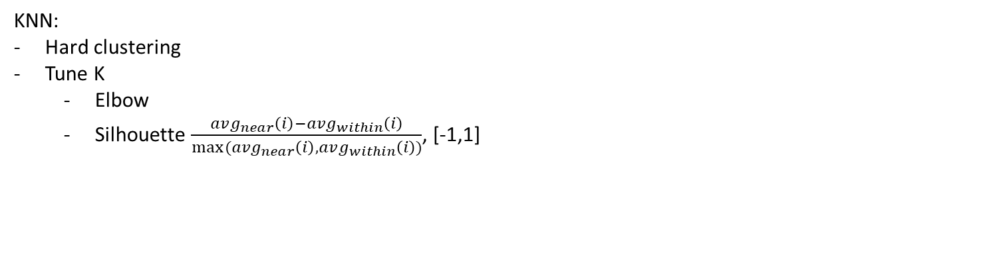
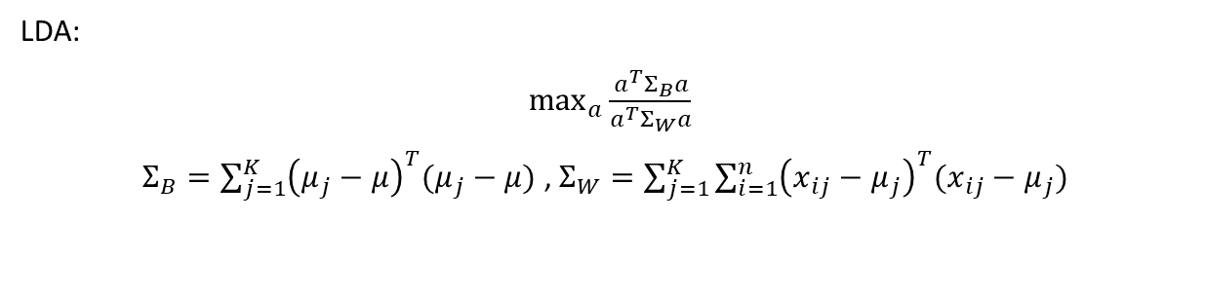
Lecture 1
LDA:
$\max_{a}{\frac{a^{T}Σ_{B}a}{a^{T}Σ_{W}a}}$
$Σ_{B}=\sum_{j=1}^{K}{{\left(μ_{j}−μ\right)}^{T}(μ_{j}−μ)}$ , $Σ_{W}=\sum_{j=1}^{K}{\sum_{i=1}^{n}{{\left(x_{ij}−μ_{j}\right)}^{T}(x_{ij}−μ_{j})}}$
KNN:
Hard clustering
Tune K
Elbow
Silhouette $\frac{avg_{near}\left(i\right)−avg_{within}\left(i\right)}{max⁡(avg_{near}\left(i\right),avg_{within}\left(i\right))}$, [-1,1]

